Slide 1


Slide 2
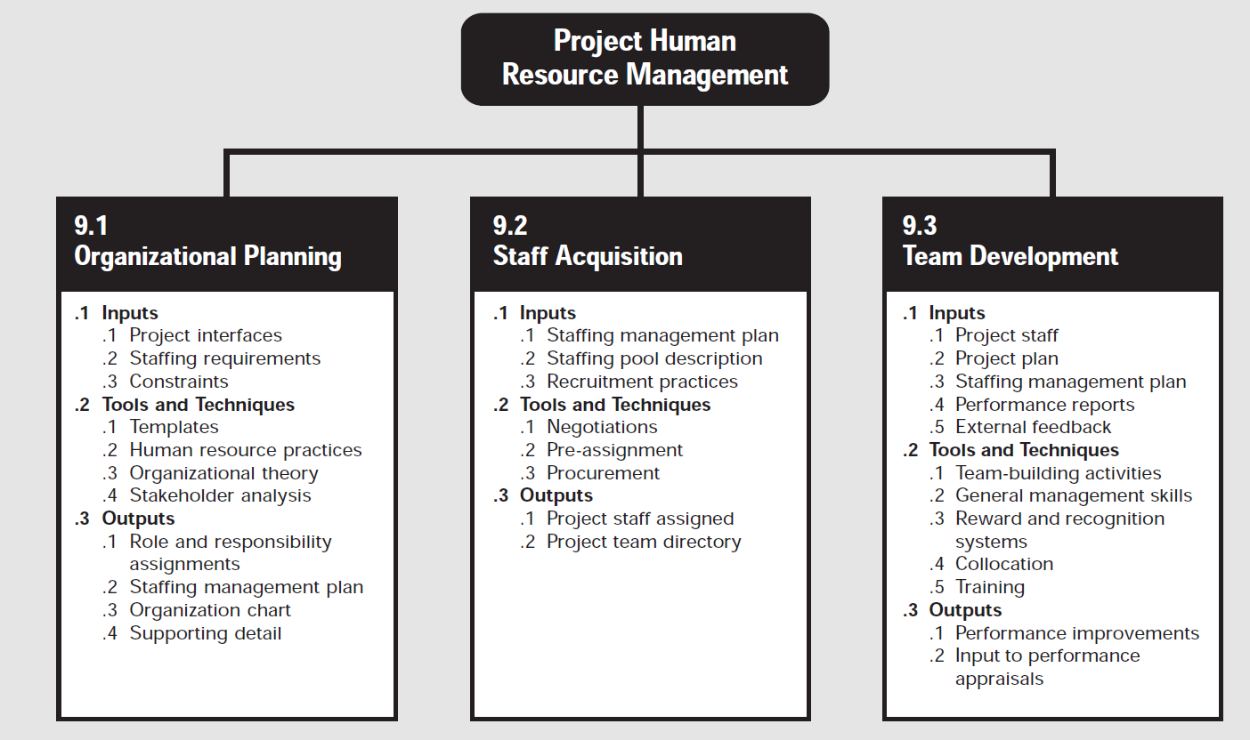


Slide 3
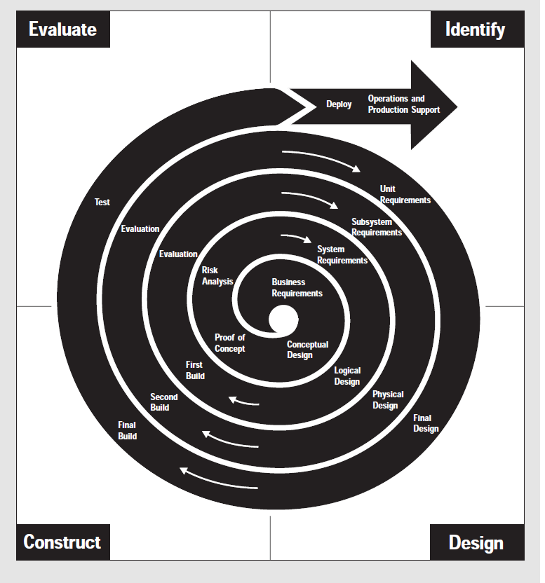

Slide 4
MOTIVATION
– Concept to Application

Slide 5
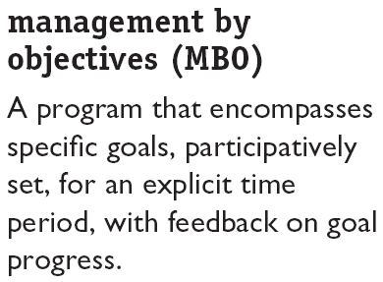
What is MBO?
Here, emphasis is to convert overall organizational objectives into specific objectives for organizational units and individual members. MBO operationalizes objectives by devising/initiating a process by which objectives cascade/ falls down through the organization.
MBO is a popular technique that originated more than 50 years ago.

Slide 6
MBO – Key Elements
Four key elements (ingredients) of any MBO programs are :
  Goal specificity. The objectives in MBO should be concise statements of expected accomplishments; e.g. To cut departmental costs by seven percent, to improve service by ensuring that all telephone orders are processed within 24 hours of receipt, or to increase quality by keeping returns to less than one percent of sales.
  Participative decision making. The objectives in MBO are not unilaterally/individually set by the boss and then assigned to employees. The manager and employee jointly choose the goals and agree on how they will be measured.

Slide 7
MBO – Key Elements
  An explicit time period. Each objective has a specific time period in which it is to be completed. Typically, three months, six months, or a year.
  Performance feedback. MBO seeks to give continuous feedback on progress toward goals so that workers can monitor and correct their own actions.
Also remember SMART goals/ objectives

Slide 8
Aspect | MBO | Goal-Setting Theory
Developed by | Peter Drucker | Edwin Locke
Type | Management technique | Motivation theory
Focus | Organizational alignment | Individual motivation
Goal Setting | Collaborative (manager + employee) | Can be self-set or assigned
Feedback | Periodic and formal | Continuous and essential
Purpose | Evaluate and improve organizational performance | Explain and improve individual performance
Orientation | Practical/Managerial | Theoretical/Psychological

Slide 9
Linking MBO and Goal-Setting Theory
MBO directly advocates specific goals and feedback:
• Implies that goals must be perceived/supposed as feasible
• Is most effective when the goals are difficult enough to require stretching/extending.
Goal-setting theory advocates demonstrates that:
• Hard goals result in a higher level of individual performance than do easy goals.
• Specific hard goals result in higher levels of performance than no goals at all or generalized goals.
• Feedback on one’s performance leads to higher performance.
The only area of possible disagreement with goal setting theory is participation—MBO strongly advocates it. Goal-setting theory (assigning goals to subordinates) frequently does not stress too much.

Slide 10
Employee Recognition Programs
Types of programs:
Personal attention – showing concern for each individual’s problem & focus on all possible help.
Expressing interest – indicating importance of individual’s task towards organizational goals.
Approval – passing positive comments and giving timely approval, where necessary.
Appreciation for a job well done – recognition & praise are the vital tools to keep the morale high.

Slide 11
Employee Recognition Programs
Benefits of recognition programs:
  Fulfills employees’ desire for recognition.
  Encourages repetition of desired behaviors.
  Enhances group/team motivation.
  Encourages employee suggestions for improving processes and cutting costs.

Slide 12
Linking Recognition Programs and Reinforcement Theory
Consistent with reinforcement theory, rewarding a behavior with recognition immediately following that behavior is likely to encourage its repetition. Recognition can take many forms:
  Personally congratulating an employee.
  Sending a handwritten note/ an e-mail message.
  Displaying name on bragging boards

Slide 13
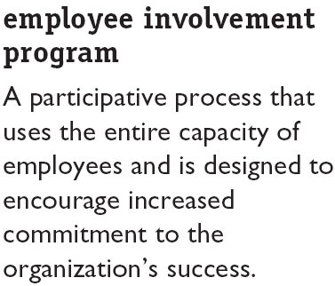

What is Employee Involvement?
  Employee involvement has become a complete/catchall term to cover a variety of techniques. It encompasses employee participation or participative management, workplace democracy, empowerment, and employee ownership.

Slide 14
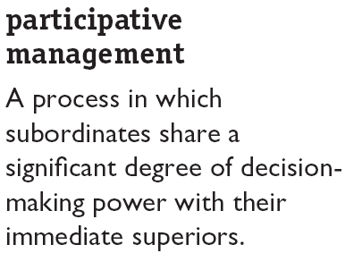

Examples of Employee Involvement Programs
Participation and employee involvement are not synonyms. Participation is a more limited term and is a subset within the larger framework of employee involvement.

Slide 15
  Why would management want to share its decision-
  making power with subordinates? The reasons are:
  a. Managers often do not know everything their
    employees do
    Better decisions
    Increased commitment to decisions
    d. Intrinsically rewarding employees makes their
    jobs more interesting and meaningful

Slide 16
Aspect | Representative Participation | Works Council
Scope | Broad concept (various forms of employee representation) | One specific form of representation
Nature | Can include board representation, joint committees, or works councils | A structured body of elected employee representatives
Function | To give employees an indirect voice in management | To discuss and negotiate workplace issues with management
Example | Employee on company’s board | German or European Works Council

Slide 17
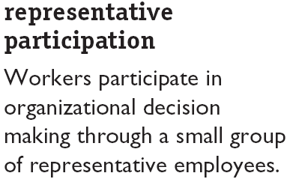
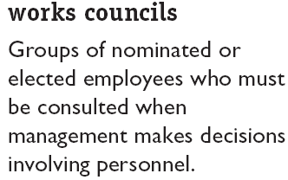
Examples of Employee Involvement Programs

Slide 18
Representative Participation: It can be elaborated as General idea of employee involvement through representatives.
Works Council It can be elaborated as A specific type of representative participation body.
All in all, all kind of works councils are and can be considered as a representative participation however, not all representative participation is a works council.

Slide 19
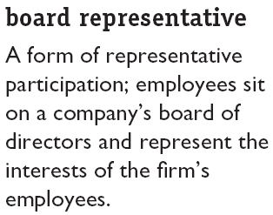
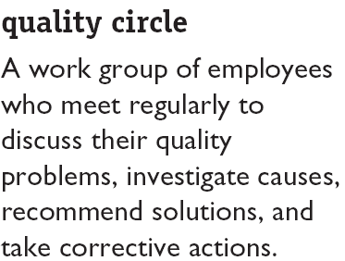


Examples of Employee Involvement Programs

Slide 20
Examples of Employee Involvement Programs
A quality circle consists of a work group of eight to ten employees and supervisors; key components are:
  They meet regularly to discuss their quality problems, investigate causes of the problems, recommend solutions, and take corrective actions.
  They take over the responsibility for solving quality problems and they generate and evaluate their own feedback.
  Management typically retains control over the implementation of final decision.

Slide 21
Examples of Employee Involvement Programs (cont’d)
  Employee Stock Ownership Plans:
  ESOPs are the company-established benefit plans in which employees acquire stock as part of their benefits.
  In the typical ESOP, an employee stock ownership trust is created. Companies contribute either stock or cash to buy stock for the trust and allocate the stock to employees. Employees usually cannot take physical possession of their shares or sell them as long as they are still employed at the company.
  The research indicates that they increase employee satisfaction, and develop sense of ownership.

Slide 22
Example:
If a company issues 1,000 shares to its employees through ESOP, each eligible employee might receive a certain number of shares depending on their position and performance. Over time, as the company’s value increases, the value of the employees’ shares also increases.

Slide 23
Variable Pay Programs
Variable Pay Programs:
These are the programs in which a portion of an employee’s pay is based on some individual and/or organizational measure of performance.
The fluctuation in variable pay programs makes them attractive to management. Four widely used programs are piece-rate wages, bonuses, profit sharing, and gain sharing.

Slide 24
Variable Pay Programs (cont’d)
Piece Rate Pay Plans:
Workers are paid a fixed sum for each unit of production completed. It is a popular means for compensating production workers. These are of two types:
  A pure piece-rate plan - the employee gets no base salary and is paid only for production. For example Selling chips packets or manufacturing key boards.
  Modified piece-rate plan - employees earn a base (fix) hourly wage plus a piece-rate differential.

Slide 25
Variable Pay Programs (cont’d)
Bonuses:
The bonus is an additional payment beyond the salary or hourly rate of pay for the year. Bonuses can be paid exclusively to executives or to all employees. Companies pay bonuses to employees to thank and congratulate them on meeting and achieving specific goals. Increasingly, bonus plans are taking on a larger net within organizations to include lower-ranking employees to reward production and increased profits.
It is one time payment; not part of pay; may be paid on special occasions or annually.

Slide 26
Variable Pay Programs (cont’d)
Profit-sharing plans:
Profit-sharing plans are the Organization wide programs that distribute compensation based on some established formula designed around a company’s profitability.
Usually cash is distributed but in some cases, particularly in the case of top managers, amount is converted into stocks.

Slide 27
Variable Pay Programs (cont’d)
Gain-sharing:
This is a formula-based group incentive plan. Improvements in group productivity—from one period to another—determine the money allocated.
Gain-sharing and profit sharing are similar but not the same thing. It focuses on productivity gains rather than profits.
Gain-sharing rewards specific behaviors that are less influenced by external factors. Employees in a gain-sharing plan can receive incentive such as encouragement and motivation awards even when the organization is not profitable.

Slide 28
Linking Variable Pay Programs and Expectancy Theory
Variable pay is probably most compatible with expectancy theory predictions. There is a strong relationship between performance and the rewards.
Group and organization-wide incentives reinforce and encourage employees to sublimate/sacrifice their personal goals for the best interests of their department or the organization.
Group-based performance incentives are also a natural extension for building a strong team ethic.

Slide 29
Skill-Based Pay Plans
Pay levels are based on how many skills employees have or how many jobs they can do. It is sometimes called competency-based pay or knowledge-based pay.
From management’s perspective, benefits are:
  Filling staffing needs is easier (interchangeable).
  Facilitates communication across the organization due to better understanding of others’ jobs.
  It lessens dysfunctional “protection of territory” behavior.
  It helps meet the needs of ambitious employees who confront minimal advancement opportunities.

Slide 30
Linking Skill-Based Pay Plans to Motivation Theories
Skill-based pay plans are consistent with several motivation theories:
  ERG (Existence, Relatedness and Growth) theory. They encourage employees to learn, expand their skills, and grow.
  Achievement need. People expand their skill levels; high achievers will find their jobs more challenging.
  Reinforcement theory. Employees are encouraged to develop their flexibility, to continue to learn, to cross-train, to work cooperatively with others.
    Skill-based pay may also have equity implications; employees will make their input-outcome comparisons.

Slide 31
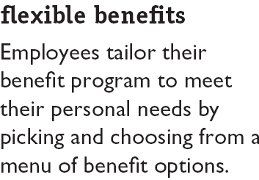
Flexible Benefits
The idea is to allow each employee to choose a benefit package that is individually tailored to his/her own needs and situation.

Slide 32
Flexible Benefits (cont’d)
There are three basic types of programs:
Core-plus Plans:
A core of essential benefits and a menu-like selection of other benefit options.
Modular Plans:
Pre-designed benefits packages for specific groups of employees.
Flexible Spending Plans:
  Employees set aside a specific dollar amount for benefits tax-free and draw against the account for medical and dental services as needed.

Slide 33
Linking Flexible Benefits and Expectancy Theory
Flexible benefits turn the benefits’ expenditure into a motivator.
Consistent with expectancy theory’s spirit (organizational rewards should be linked to each individual employee’s goals), flexible benefits individualize rewards by allowing each employee to choose the compensation package that best satisfies his/her current needs.

